Slide 1
Announcements
R function cheat-sheet (thanks Natalie!)
Please use provided .Rmd file for take-home exam

Slide 2
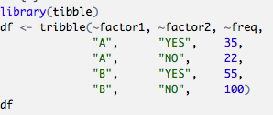
Exercise 1: Entering contingency tables into R
Predation
Enter the data from this contingency table into R, and create a contingency table object.
Hint: You can use Excel and save as a .csv file to read into R as usual OR use tribble() from the tibble package
Snail color pattern | Broken | Intact | Row totals
Banded | 182 | 403 | 585
Unbanded | 116 | 385 | 501
Column totals | 298 | 788 | 1086

Slide 3
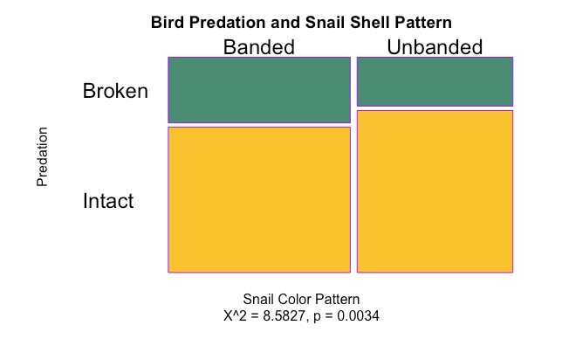
Exercise 2: make a mosaic plot!
Make a mosaic plot for the snail data you entered earlier.
Make it your own by changing colors and axis labels.
Dig around in the help file to see what other graphical parameters you can change!

Slide 4
Want to know more?
R for Data Science (http://r4ds.had.co.nz/)
Focus on data manipulation (”wrangling”) and visualization using the tidyverse (ggplot2, dplyr, tidyr, etc.)
Cookbook for R (cookbook-r.com)
Similar to our syllabus, more in-depth, additional statistical tests
Ecological models and Data in R (used in Bio133) (https://ms.mcmaster.ca/~bolker/emdbook/)
Focus on likelihood and modeling
The R Book
Focus on statistics by type of data (count, proportion, time-series, etc.)
http://www.transmittingscience.org/courses/statistics-and-bioinformatics/r-without-fear-applied-r-biologists/
https://www.edx.org/course/statistics-r-harvardx-ph525-1x-0

